Slide 1
Pedestrian Tracking & Corner Detection of An Image Using NXP S32V234 Vision Processor
Supervised by
Dr. Mohamed El-Sharkawy
Professor
Dept. of ECE, IUPUI
Date : 25 April, 2018
Presented by
Md Saiful Islam
Raj Jatin Shah
Abir Saha

Slide 2
Outlines of Presentation
Project Overview
Project Application
System Implementation
Project Workflow
Procedure
Attempts and Results
Solution
Motivation & References
Q/A session

Slide 3
Project Overview
Taking Image from specific location.
Building project model using Apex Graph Tool.
Process image using S32V234 Vision Processor and detect face and corner to take decision as an autonomous car.

Slide 4
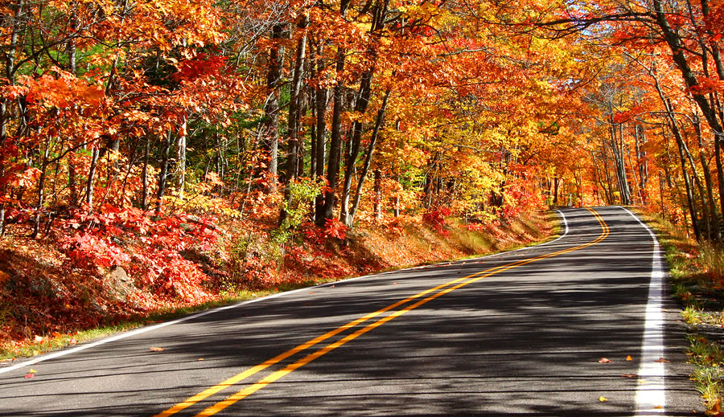
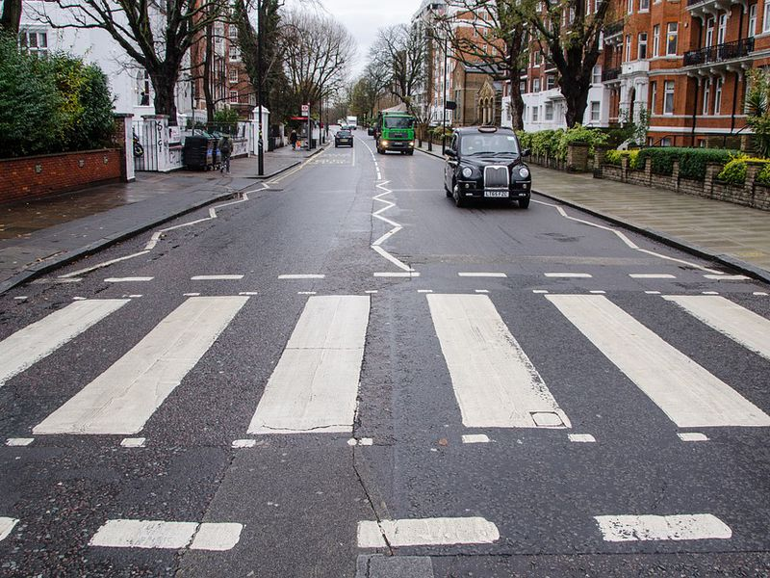
Project Application
Detecting lane and road edge
Detecting Pedestrian crossing

Slide 5
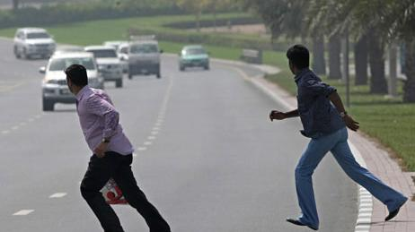
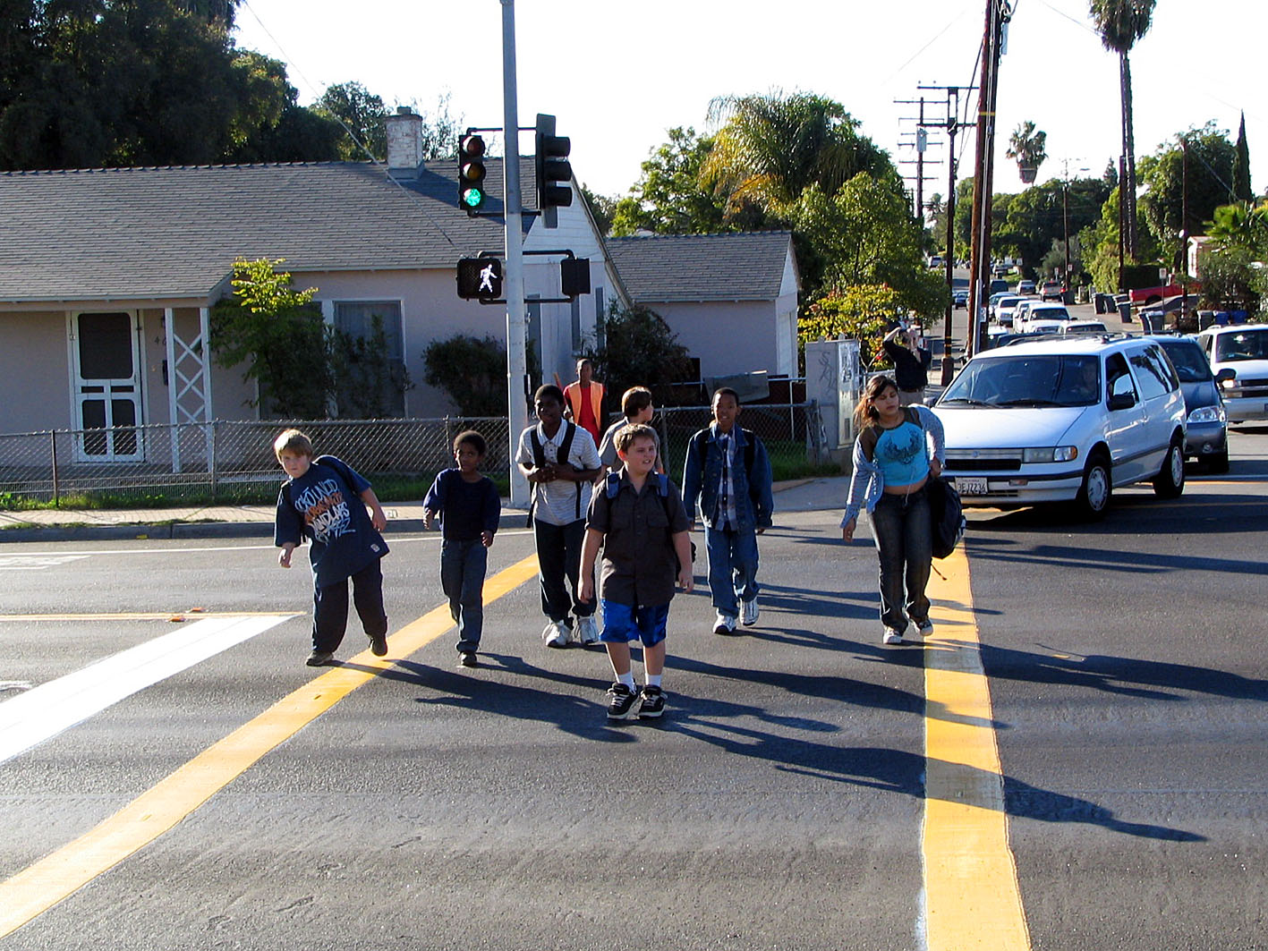
Project Application
Face Detection on emergency
Face Detection on zebra crossing

Slide 6
System Implementation
NXP S32V234 board Evaluation Board
S32 Design Studio for Vision v2.0 IDE
Micro SDHC card
USB Micro B to USB A cable, Ethernet to USB cable
Power supply for NXP S32V234 board
Laptop

Slide 7
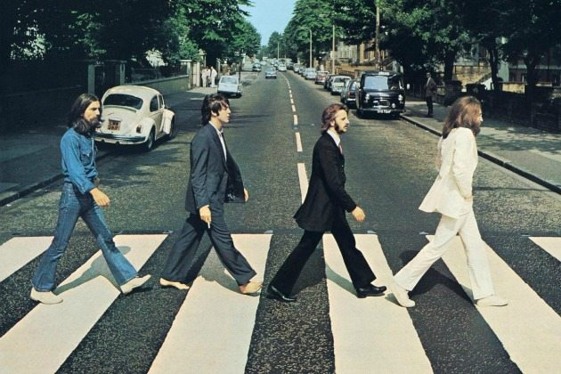
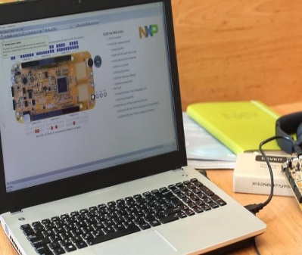
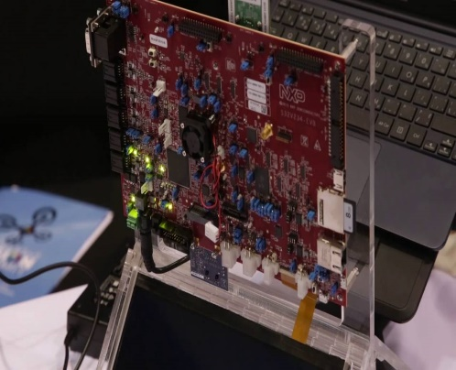
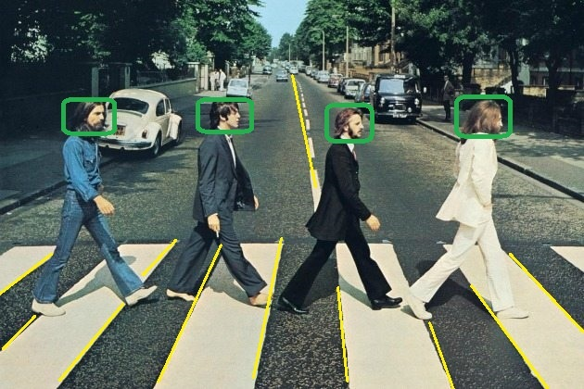
Project Work Flow
S32 for Vision
Image and
algorithm
Edge detection and pedestrian detection results
Processing on APEX2

Slide 8
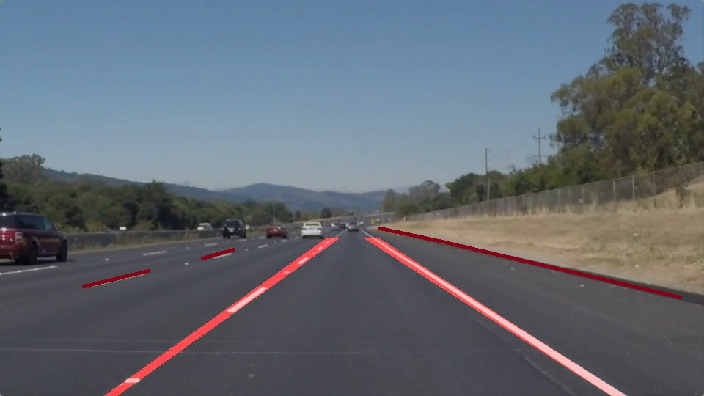
Procedure
Edge or Corner detection algorithm:
Purpose: Detection for road edge, lane or pedestrian crossing edge
Apex graph tool kernel support needed
Example: Harris, Canny, Fast9

Slide 9
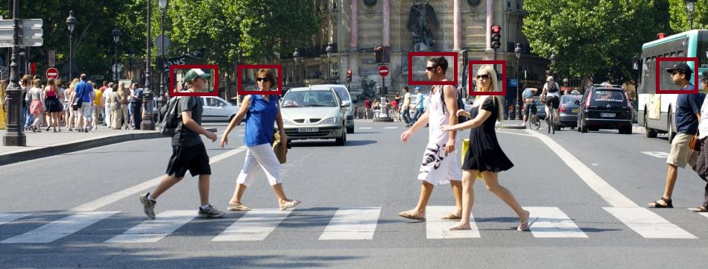
Procedure
Face or Object detection Algorithm:
Purpose: detection of road pedestrian
Apex graph tool kernel support needed
Example: Haar-cascade, ORB, LBP Algorithm.

Slide 10
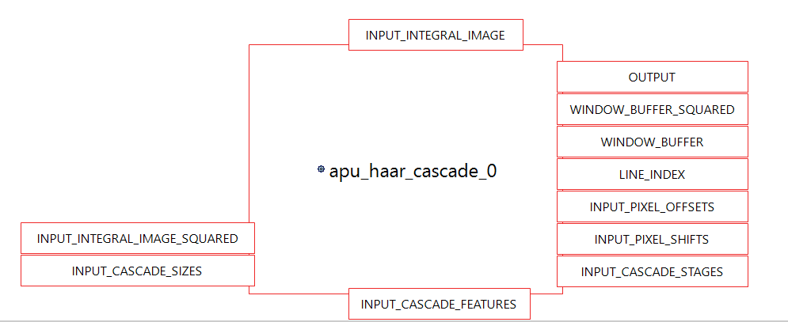
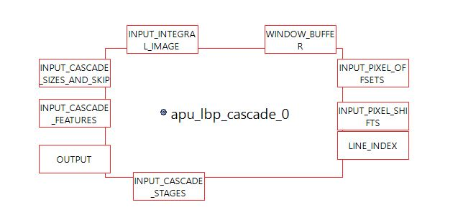
Attempts and Results
Haar-cascade and LBP algorithm for face detection
Too many I/O for kernel

Slide 11
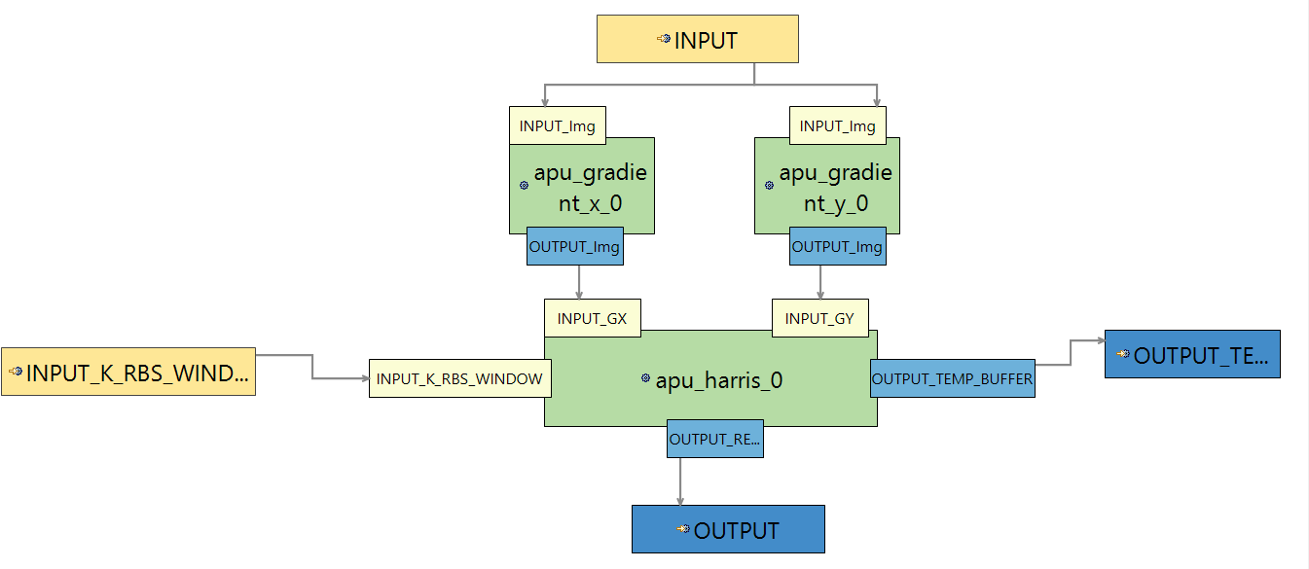
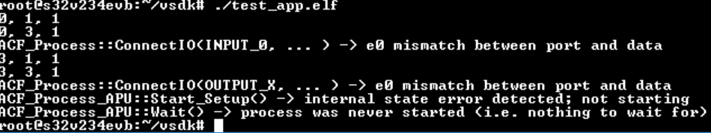
Attempts and Results
Harris algorithm for edge detection
Mismatching interfacing with different kernels

Slide 12

Attempts and Results
APEX and ISP Lane detection application using Hough Line Detector
Produces completely green output, no actual image visible

Slide 13
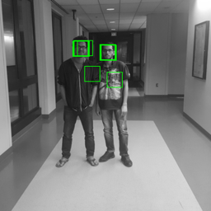
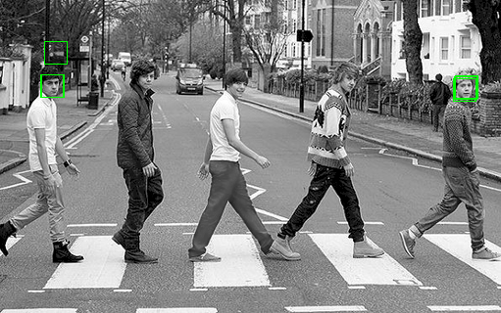
Attempts and Results
Imported and ran face detection project
Based on Local Binary Patterns (LBP) algorithm
Detecting faces for different images

Slide 14
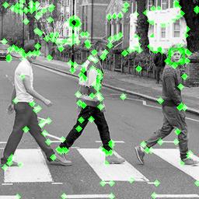
Attempts and Results
Imported and ran fast9 project
Based on fast9 corner detection algorithm
Detecting corners for image

Slide 15
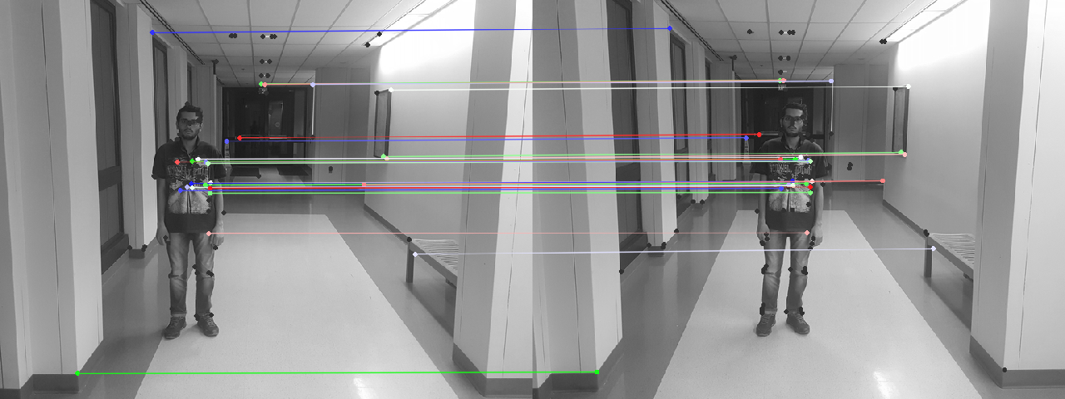
Attempts and Results
Imported and ran ORB project
Based on Oriented FAST and rotated BRIEF (ORB) algorithm
Tracking pedestrian by comparing image frames

Slide 16
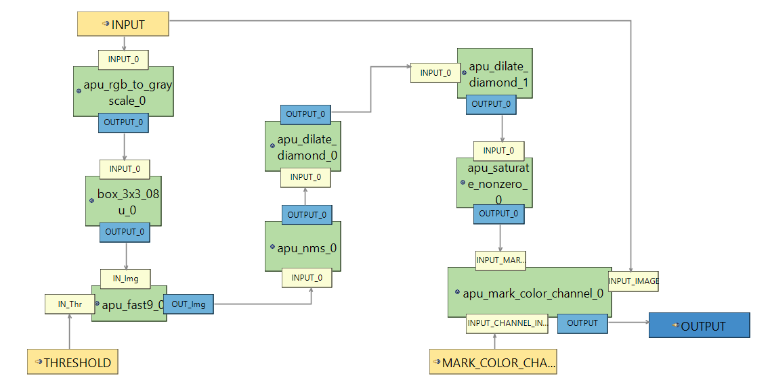
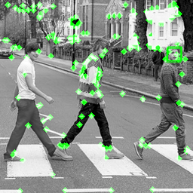
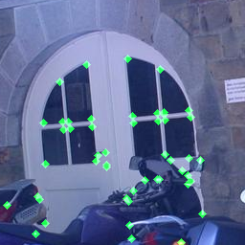
Attempts and Results
Modified Fast9 algorithm for edge detection

Slide 17
Solution
Solution:
Fast9 for edge detection algorithm and ORB algorithm for pedestrian detection
Incorporate Fast9 algorithm and ORB algorithm in a single graph to detect edge and pedestrian at the same time

Slide 18
Motivation & References
https://community.nxp.com/
Kernels Reference Manual
ECE595-Autonomous Embedded System Lab Manual
https://docs.opencv.org/3.0-beta/doc/py_tutorials/py_feature2d/py_fast/py_fast.html
https://docs.opencv.org/2.4/doc/tutorials/features2d/trackingmotion/harris_detector/harris_detector.html
https://www.nxp.com/video/:S32V234-Vision-Processor-4
https://www.nxp.com/video/:S32V234-Vision-Processor
https://docs.opencv.org/3.4.1/d7/d8b/tutorial_py_face_detection.html

Slide 19
Q/A session
Thanks for your patience.

